Slide 1
Software Process Improvement
COMP6100001 - Software engineering
Session 22
Kenny Jingga, S.Kom., M.T.

Slide 2
Session 22 – Software Process Improvement
Learning objectives
At the end of this session, students will be expected to be able to:
Understand the Concept and Importance of Software Process Improvement (SPI)
Describe Key Models for Software Process Improvement
Explore Strategies and Metrics for Effective Process Improvement
Analyze Case Studies on Real-World SPI Implementation

Slide 3
Session 22 – Software Process Improvement and METRICS and Measurements
Content outline
Introduction to Software Process Improvement (SPI)
Software Process Improvement Models
Strategies for Enhancing Software Processes
Measuring Process Improvement Success
Case Studies and Real-world Examples

Slide 4
Introduction to Software Process Improvement (SPI)
Overview and Importance
Software Process Improvement (SPI) refers to the practice of assessing and enhancing software development processes to improve quality, productivity, and predictability. SPI aims to identify weaknesses in current processes and implement changes that lead to better performance and outcomes.
Importance of SPI:
Quality Enhancement: Improves the quality of software products.
Productivity Increase: Streamlines processes to reduce time and cost.
Risk Reduction: Identifies and mitigates potential issues early.
Customer Satisfaction: Leads to higher satisfaction through reliable delivery.
Competitive Advantage: Positions organizations better in the market.

Slide 5
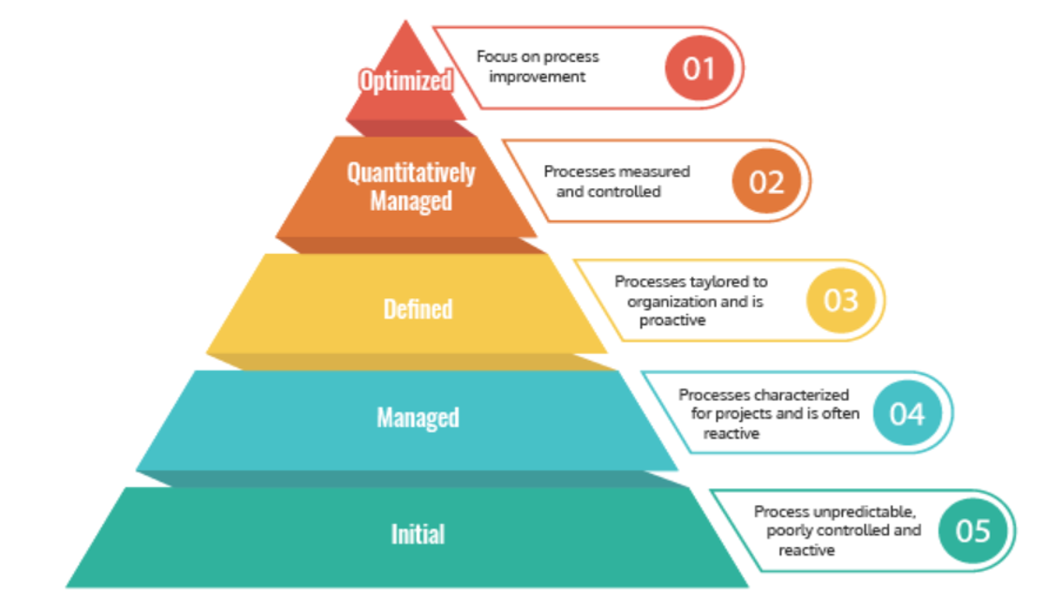
Software Process Improvement Models
Capability Maturity Model (CMM)
Definition: The Capability Maturity Model (CMM) is a framework that describes the key elements of an effective software process.
Purpose: Provides organizations with guidance on how to gain control of their processes for developing and maintaining software.

Slide 6
Software Process Improvement Models
Capability Maturity Model (CMM): Maturity Levels
Initial (Level 1): Processes are unpredictable, poorly controlled, and reactive.
Repeatable (Level 2): Basic project management processes are established to track cost, schedule, and functionality.
Defined (Level 3): Processes are documented, standardized, and integrated into a standard process for the organization.
Managed (Level 4): Detailed measures of the software process and product quality are collected and controlled.
Optimizing (Level 5): Continuous process improvement is enabled by quantitative feedback and from piloting innovative ideas and technologies.

Slide 7
Software Process Improvement Models
Capability Maturity Model (CMM): Key Process Area (KPAs)
Level 2 KPAs: Requirements Management, Project Planning, Project Tracking and Oversight, Subcontract Management, Quality Assurance, Configuration Management.
Level 3 KPAs: Organization Process Focus, Process Definition, Training Program, Integrated Software Management, Product Engineering, Intergroup Coordination, Peer Reviews.
Level 4 KPAs: Quantitative Process Management, Software Quality Management.
Level 5 KPAs: Defect Prevention, Technology Change Management, Process Change Management.

Slide 8
Software Process Improvement Models
Benefits and Criticisms of CMM
Benefits:
  Improved Quality: Systematic processes lead to higher quality products.
  Predictability: Better estimation of schedules and costs.
  Customer Satisfaction: Enhanced reliability and delivery.
  Process Improvement: Framework for continuous improvement.
Criticisms:
  Cost and Time: Implementation can be expensive and time-consuming.
  Rigidity: May not suit all organizational cultures, especially smaller or more agile ones.

Slide 9
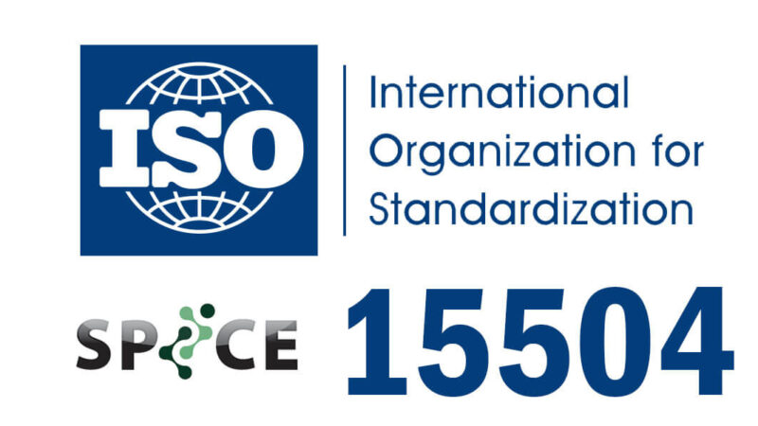
Software Process Improvement Models
Other SPI Models: ISO/IEC 15504 (SPICE)
Definition: An international standard for software process assessment.
Purpose: Provides a framework for assessing the maturity of software development processes.
Process Capability Levels: Incomplete, Performed, Managed, Established, Predictable, Optimizing.

Slide 10
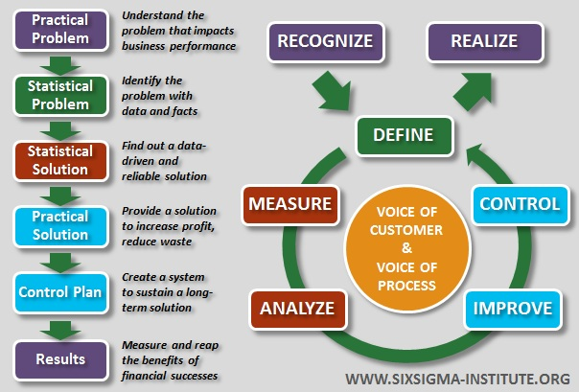
Software Process Improvement Models
Other SPI Models: Six Sigma
Definition: A data-driven approach for eliminating defects and improving quality in any process.
Purpose: Aims for near perfection in process performance.
Key Concepts: DMAIC methodology (Define, Measure, Analyze, Improve, Control).

Slide 11
Strategies for enhancing software processes
1. Process Assessment
Purpose:
  Evaluate current processes to identify strengths and weaknesses.
  Establish a baseline for improvement.
Methods:
  Appraisals and Audits: Formal evaluations against standards like CMM.
  Surveys and Interviews: Gathering input from team members and stakeholders.

Slide 12
Strategies for enhancing software processes
2. Process Modeling and Analysis
Purpose:
  Understand and visualize existing processes.
  Identify inefficiencies and bottlenecks.
Techniques:
  Flowcharts: Visual representations of process steps.
  Unified Modeling Language (UML): Standardized modeling language for specifying, visualizing, and documenting processes.

Slide 13
Strategies for enhancing software processes
3. Change Management
Importance:
  Effective SPI requires managing the human and organizational aspects of change.
  Resistance to change can impede process improvement efforts.
Strategies:
  Communication: Clearly explain the need and benefits of changes.
  Training: Equip team members with necessary skills and knowledge.
  Involvement: Engage stakeholders in the change process.

Slide 14
Strategies for enhancing software processes
4. Continuous Improvement Practices
Kaizen:
  Definition: A Japanese term meaning "change for better" or continuous improvement.
  Application: Implement small, incremental changes regularly.
Plan-Do-Check-Act (PDCA) Cycle:
  Plan: Identify an opportunity and plan for change.
  Do: Implement the change on a small scale.
  Check: Analyze the results of the change.
  Act: If successful, implement it on a larger scale.

Slide 15
Measuring process improvement success
Key Performance Indicators (KPIs)
Quantifiable measures used to evaluate the success of an organization or process in meeting objectives.
Common Software Process KPIs:
  Defect Density: Number of defects per size unit (e.g., per 1,000 lines of code).
  Cycle Time: Time taken to complete a process from start to finish.
  Customer Satisfaction Index: Feedback scores from customers.
  Return on Investment (ROI): Financial benefits gained from process improvements.

Slide 16
Measuring process improvement success
Metrics and Measurement Techniques
Importance of Metrics:
  Provides objective data to assess process performance.
  Facilitates informed decision-making.
Types of Metrics:
  Product Metrics: Measure characteristics of the software product (e.g., size, complexity).
  Process Metrics: Measure aspects of the development process (e.g., effort, time).
  Project Metrics: Measure project progress and performance (e.g., schedule variance).

Slide 17
Measuring process improvement success
Benchmarking
Definition:
  Comparing one's processes and performance metrics to industry bests or best practices from other organizations.
Benefits:
  Identifies performance gaps.
  Provides insights into best practices.
  Sets realistic improvement goals.

Slide 18
Case Studies and Real-world Examples
Case Study: Implementing CMM in a Mid-sized Software Company
Background:
  A mid-sized software development company faced issues with project delays and high defect rates.
  Decided to adopt CMM Level 3 to improve processes.

Slide 19
Case Studies and Real-world Examples
Case Study: Implementing CMM in a Mid-sized Software Company
Implementation Steps:
Assessment: Conducted a gap analysis to identify areas needing improvement.
Training: Provided CMM training to staff.
Process Definition: Developed standardized processes and documentation.
Pilot Projects: Implemented new processes in select projects.
Review and Refine: Collected feedback and made necessary adjustments.

Slide 20
Case Studies and Real-world Examples
Case Study: Implementing CMM in a Mid-sized Software Company
Results:
  Improved Quality: Defect rates reduced by 30%.
  On-time Delivery: Project delays decreased significantly.
  Customer Satisfaction: Positive feedback from clients increased.

Slide 21
References
Paulk, M. C., Curtis, B., Chrissis, M. B., & Weber, C. V. (2017). Capability Maturity Model for Software, Version 2.0. Software Engineering Institute.
Pressman, R. S. (2020). Software Engineering: A Practitioner's Approach (9th ed.). McGraw-Hill.

